Slide 1
Access Database
Project database

Slide 2
Main purpose is to Close the communication gape between the following department:-
1- Contracts.
2- PMT.
3-Manpower control.
4-Logistic.
5-Quality.
6-Safety.
7-Procurement.
8-Aramco Doc.

Slide 3
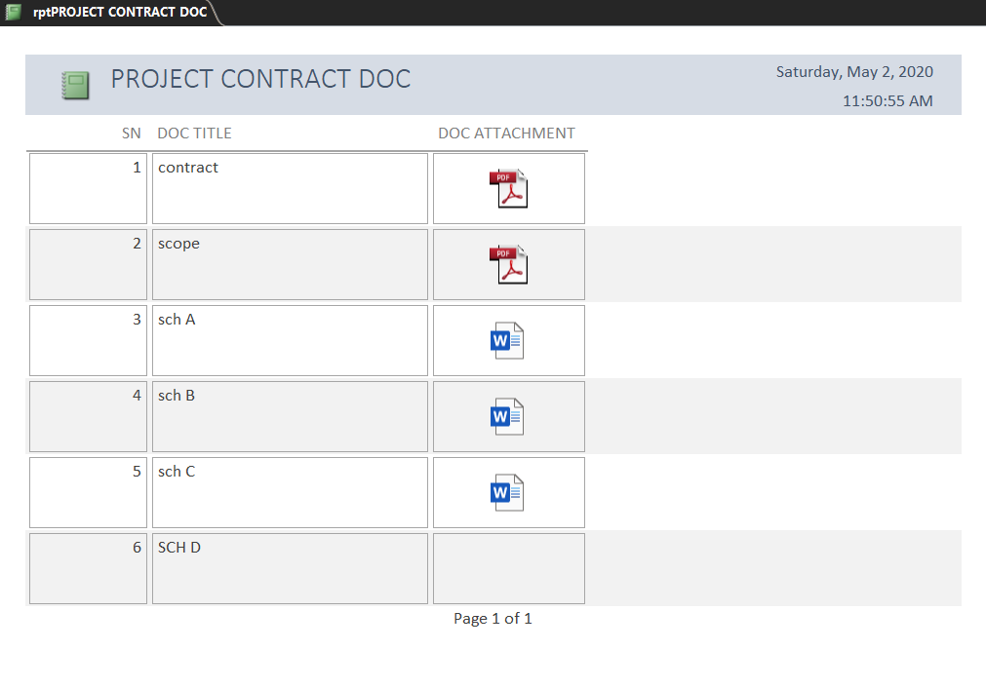
Contracts
Attach all documents related to the project and pass it to the project manager.

Slide 4
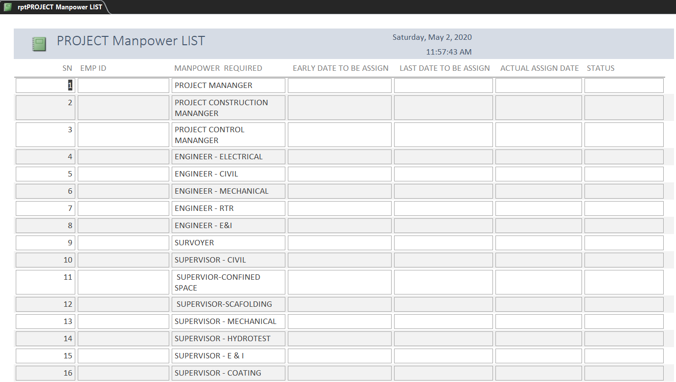
PMT
Manpower

Slide 5
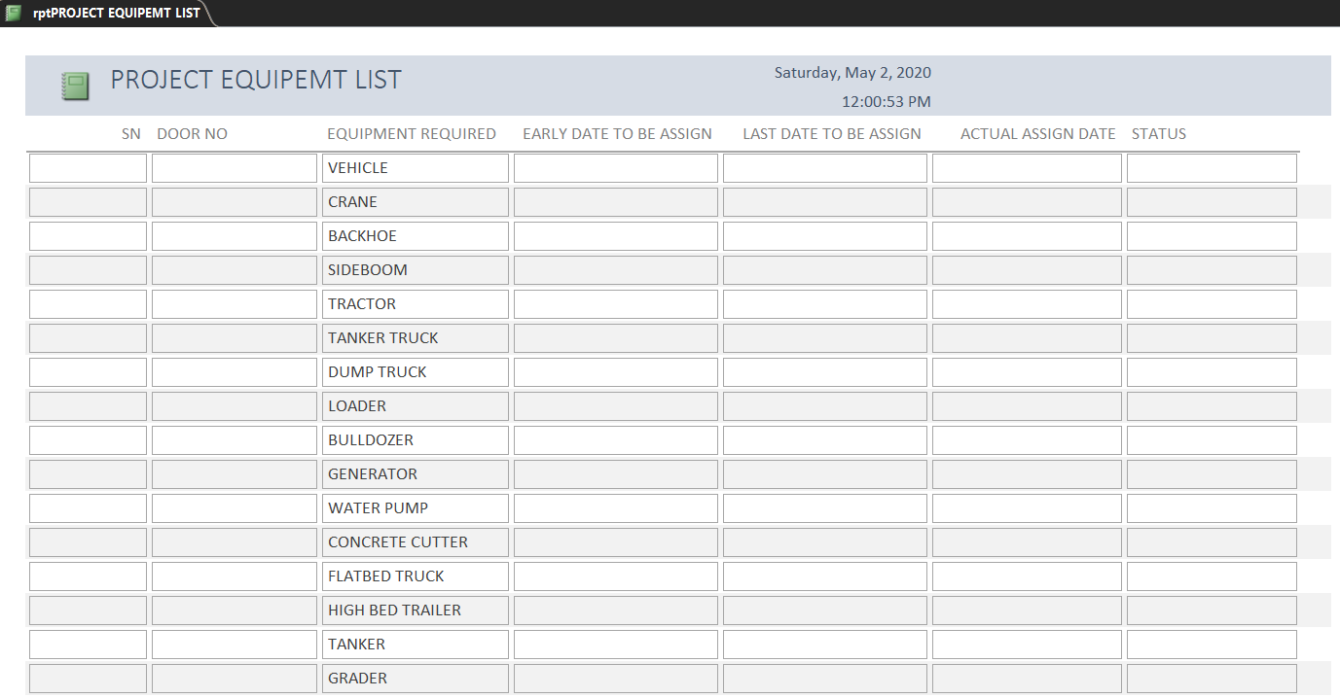
Equipment

Slide 6
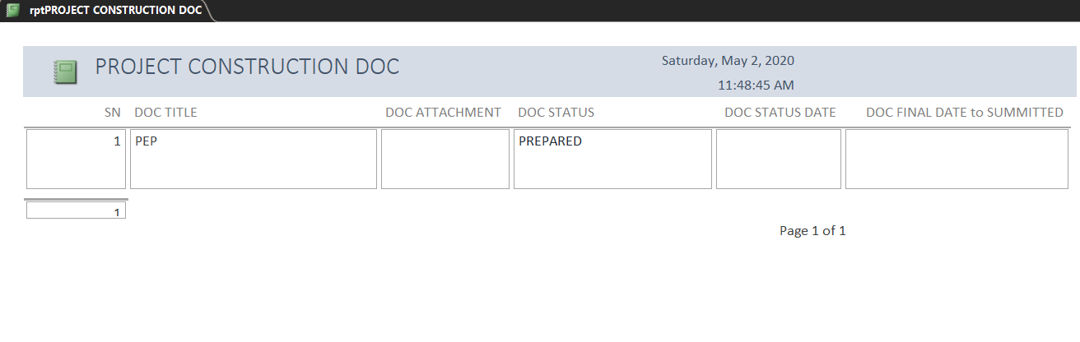
Construction DOC

Slide 7
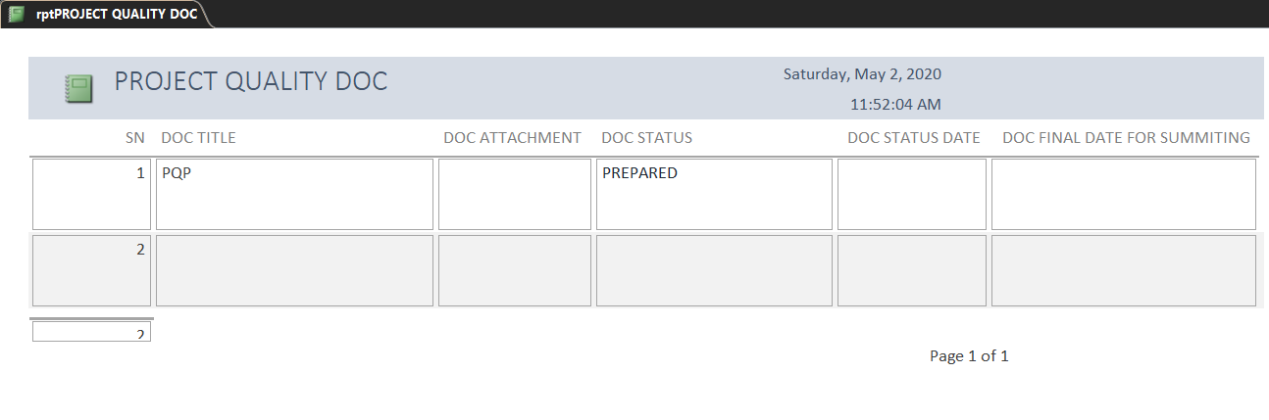
Quality

Slide 8
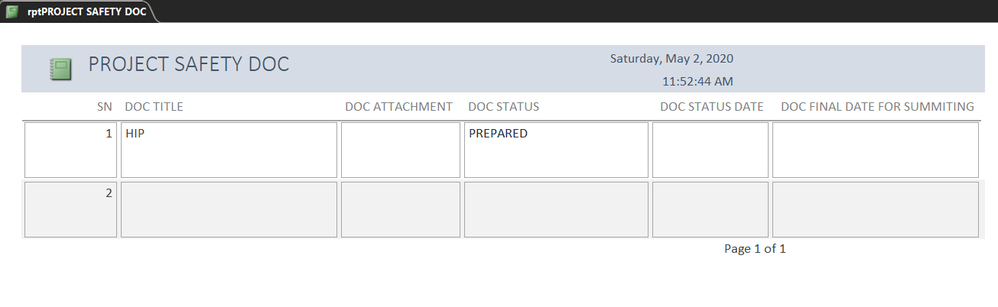
Safety

Slide 9
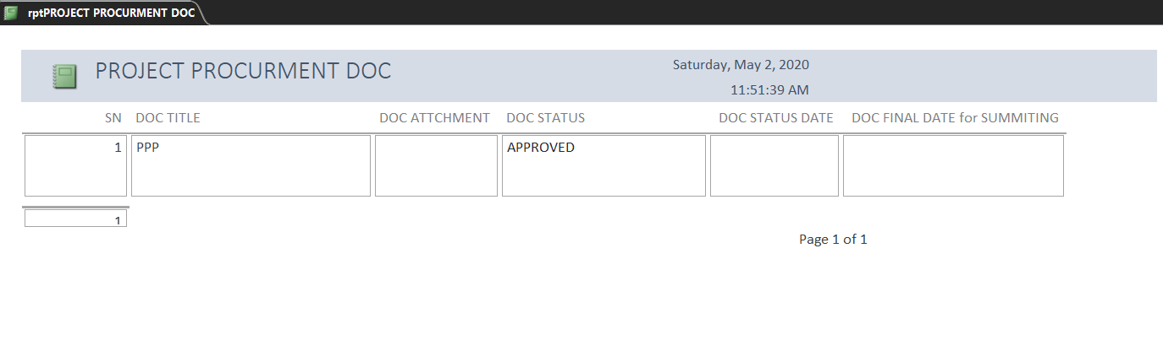
Procurement

Slide 10
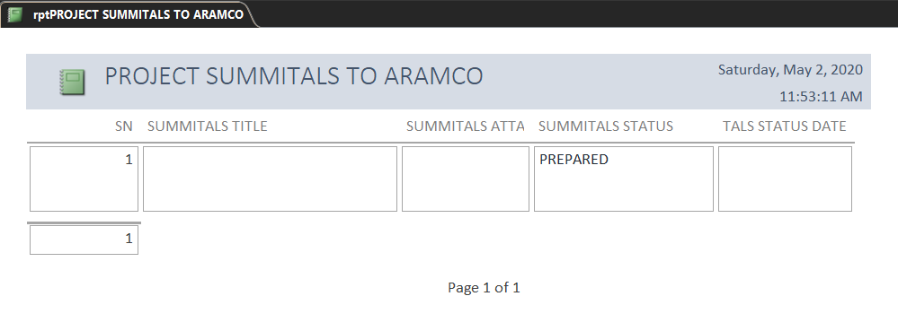
Aramco Doc.

Slide 11
Access database
Company database

Slide 12
Control the resources of the company
Manpower
Equipment

Slide 13
manpower
Available and Balance discipline.
Location.
Nationality.
Iqama &Safety card expire date.
Rental.
Cost.

Slide 14
equipment
Available and Balance.
Last maintains date.
Status
MVPI &ESTMARA &INSPECTION STICKER expire date.
Users
Rental
Cost.

